Slide 1
Session 1: MEL Fundamentals
16th July 2025

Slide 2
Topics to be covered in this session
Introduction to MEL Concepts
Log Framework
Introduction to ToC
Implement ToC Framework
Steps to build ToC
What and why use MEL, Common tools, methods & approaches
Understand Logical Framework Approach
Why shift to ToC, its necessity, understand ToC framework
Step-by-step guide to build a ToC
Apply the framework to content

Slide 3
Introduction to MEL Concepts

Slide 4



What is MEL?
Monitoring, Evaluation, and Learning (MEL) is a structured approach to understand and improve program performance.
Regularly tracking progress of activities to ensure they are on course and understanding why things are working or not.
Monitoring
Using insights from monitoring and evaluation to inform better decisions, adapt strategies, and improve future programs.
Learning
Evaluation
Assessing the project’s effectiveness and impact at key points (during or after implementation).

Slide 5

Quiz:
Scan the QR using your cameras
https://forms.fillout.com/t/rP1ibbMSwZus

Slide 6
Why and Where to Use MEL?
In your chats, quickly write:
How have you been using MEL in your work?
......

Slide 7
MEL Tools
Specific instruments or techniques used to collect or organize information for M&E.
Tool | Description & Use | Advantages | Disadvantages
Performance Indicators | Measures inputs, outputs, outcomes, and impacts to track progress, set performance targets, and identify problems. | - Clear tracking of objectives - Benchmarking comparisons across units or time | - Poorly defined indicators mislead - Trade-off between picking the optimal indicators and accepting from existing data
Formal Surveys | Standardized data collection from selected samples, providing baseline data, group comparisons, and insights into conditions. | - Generalizable to larger populations - Allows quantitative estimates of impact size and distribution | - Expensive and time-consuming - Limited flexibility for qualitative insights
Public Expenditure Tracking Surveys (PETS) | Tracks flow of public funds to ensure resources reach target groups and identifies inefficiencies in service delivery. | - Supports accountability - Pinpoints bottlenecks in fund flow | - Reluctance of agencies to open records - Cost is substantial

Slide 8

Common Planning Tools/ Methods
Stakeholder Analysis
Logical Framework
Theory of Change
Weaver’s Triangle
Developing Indicators
Scenario: Improving Nutrition Among Pregnant Women in Rural Maharashtra
Stakeholders : Pregnant women, ASHA workers, Anganwadi staff, local health officials, and family members who influence dietary habits.
Logical Framework:
Input: Nutrition kits and awareness sessions
Activity: Monthly community meetings and home visits
Output: Increased knowledge of dietary needs
Outcome: Improved maternal nutrition
Goal: Reduced maternal and infant mortality
Indicators: % of women attending sessions, Average weight gain during pregnancy, Number of home visits completed, etc

Slide 9

Common Monitoring Tools/ Methods
Data Collection Tools: Interviews - FGDs & KIIs, Questionnaires/Surveys, Case Studies
Media Monitoring
MIS
Scenario: Promoting Adolescent Girls' School Attendance in Bihar
Stakeholders : Adolescent girls, parents, school teachers, headmasters, local education officers, and community influencers.
Data Collection:
Focus Group Discussions with girls and parents to explore challenges
Key Informant Interviews with teachers and headmasters to assess school support mechanisms.’
Structured surveys conducted every quarter to track attendance, dropout rates, and perceptions about schooling.
In-depth stories of 4–5 girls who overcame barriers (e.g., transport, menstrual hygiene, early marriage) to continue education.
Trackers set in place.

Slide 10

Common Evaluation Tools/ Methods
Impact evaluation
Process Evaluation
Economic Evaluation: Cost-effectiveness Analysis (CEA)
Outcome Mapping
Evaluation Timing: Baseline, Midline & Endline Evaluation
Outcome Harvesting
Most Significant Change
Longitudinal Study
Scenario: Improving Digital Literacy Among Government School Students in Karnataka
Stakeholders : Students, schoolteachers, parents, School Management Committees (SMCs), and the Department of Education.
Evaluation:
Baseline: Only 15% of students have ever used a computer; less than 10% can type or access digital learning content.
Midline (End of Year 1): 60% of students can now operate a computer, use basic apps like MS Word and Paint; teachers report higher engagement.
Endline(End of Year 2): 80% of students can create presentations, documents and browse safely online.

Slide 11

Common Learning Tools/ Methods
Written products (reports, blogs)
Facilitated discussions
Forum/ Conferences
Changes in design
Scenario: Youth Employability Program A program trained rural youth (ages 18–24) in soft skills and job readiness to improve employment outcomes.
Learning from Monitoring & Evaluation:
Post-training surveys and follow-up interviews showed many youth were not attending interviews, despite completing the training.
A short internal brief identified low confidence and fear of migration as reasons for low interview turnout.
This learning was shared in a team review meeting. As a result, the program team added mock interview sessions and peer learning sessions to boost confidence and address concerns.

Slide 12
Common MEL Methods
Systematic procedures used to collect, analyze, and interpret data to inform decision-making.
Method | Rapid Appraisal Methods | Participatory Methods
Description & Use | Quick, low-cost ways to gather stakeholder feedback for decision-making, particularly in dynamic situations. | Engages stakeholders in planning and decision-making, fostering ownership and sustainability of results.
Advantages | - Fast and flexible - Low cost | - Builds local capacity - Ensures relevance and responsiveness
Disadvantages | - Limited generalizability - Less rigorous than formal surveys | - Time-intensive - Risk of misuse by powerful stakeholders

Slide 13
Common MEL Methods
Systematic procedures used to collect, analyze, and interpret data to inform decision-making.
Method | Cost-Benefit & Cost-Effectiveness Analysis | Impact Evaluation
Description & Use | Evaluates whether costs are justified by benefits (cost-benefit) or outcomes (cost-effectiveness) using monetary or non-monetary measures. | Assesses intended and unintended effects on individuals, institutions, and the environment, distinguishing outcomes from external influences.
Advantages | - Helps allocate resources efficiently - Convinces funders of value | - Measures magnitude of impact - Answers critical “what works” questions
Disadvantages | - Requires significant financial expertise - Highly dependent on assumptions | - Expensive and time-consuming - Reduced utility when decision-makers need information quickly

Slide 14
Two Common MEL Approaches
Overarching frameworks or philosophies guiding the design, implementation, and use of M&E
Approach | Description & Use | Advantages | Disadvantages
Logical Framework Approach (LogFrame) | Clarifies objectives across the results chain (inputs to impact), identifies indicators, and assesses risks. | - Guides systematic planning - Engages stakeholders - Improves design and M&E | - Risk of rigidity - Needs updating to reflect changing conditions
Theory-Based Evaluation | Explores program logic in-depth, mapping causal pathways and success factors, without assuming linear cause-effect relationships. | - Provides early feedback - Identifies unintended side-effects - Prioritize which issues to investigate in greater depth, | - Complexity risk - Time-consuming due to stakeholder disagreements

Slide 15
Example of a Log Frame
 | Project Description | Indicators | Data sources | Assumptions
Goal | To reduce gender disparities in enrolment, retention and completion at primary level | Net enrolment rate (male/female) | School Records, National Statistics | That all enrolments to schools are recorded and available
Outcome | Girls claim their right to primary education in districts X and Y in order to transition to secondary school, gain qualifications, and improve their life chances and wellbeing | Number of girls who complete primary six (in comparison to boys) | - School records, district budget - Girls, parents, community leaders, teachers | There is not situation of conflict, drought or famine to disrupt the school year
Output | - Improved understanding of the importance of girls’ education Improved quality of teaching at primary level | - Perception of the importance of girls education - Number of teachers supported to provide quality education | - Girls, parents, community leaders, teachers - Training records, teachers | - Parents and community members are able to attend awareness raising events - Teachers are supported to attend training
Activity | - Community outreach sessions on importance of girls education - Provide volunteer mentors to teachers | - Uptake of outreach sessions - Number of teachers mentored | - Girls, parents, community members - Teachers | - Staff can gain access to target areas - Teachers are given permission by employer to work with mentor
Notes:
Problem: Small farmers in India have low profits in agriculture. They are unable to come out of their debt cycle.
Goal - To increase incomes of farmers

Slide 16
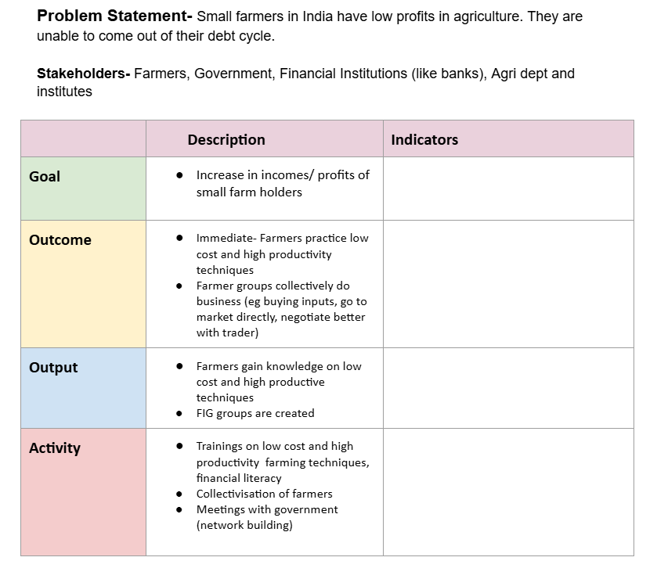
Activity

Slide 17
Why shift from log frame to ToC?
Linear Logframe
Oversimplifies complex problems.
Complexity
ToC captures intricate contexts.
Assumptions
ToC reveals underlying beliefs.
Strategic Vision
ToC builds shared long-term goals.
Theory of Change

Slide 18
When to use log frame & ToC?
Theory of Change
Logical Framework
The project is complex with multiple stakeholders
Long-term, strategic change is the focus
Understanding assumptions and context is important
You want to map how and why change happens
Planning starts before the intervention
The project is simple and linear
Short- or medium-term project management is needed
You need a quick summary of inputs to outcomes
Donor reporting and structured formats are required
The project is already designed and needs organizing

Slide 19
Theory of Change

Slide 20
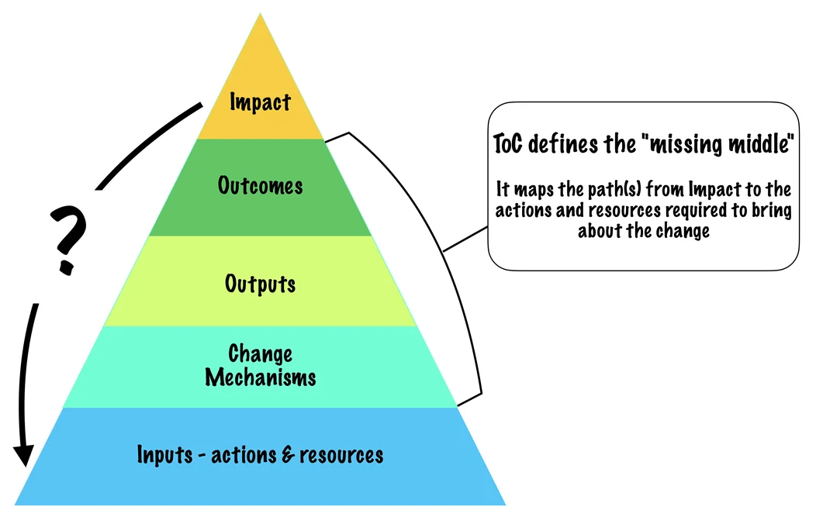
What is ToC?
A Theory of Change (ToC) explains how and why a program or intervention is expected to lead to its desired impact.
Key Features:
Describes the pathway from activities to long-term goals
Identifies goals, assumptions, interventions, and preconditions
Highlights both positive and negative impacts
Considers context and other influencing factors
Useful for designing, evaluating, and improving programs

Slide 21
Why is a ToC Necessary?
Strengthen Impact Evaluation
Provides a clear basis for measuring success and demonstrating accountability
Enhance Program Design
Helps identify key drivers of change, making interventions more focused and effective
Support Strategic Decision-Making
Improve Communication with Stakeholders
Guides resource prioritization by highlighting what matters most for long-term impact
Visually conveys the purpose and impact to both internal teams and external audiences

Slide 22
QnA
(Any discrepancy, query, issues?)

Slide 23
Thank you!

